Slide 1
Sentiment Analysis on Social Media Reporting on Demonetization
1.) AMBUJ MISHRA - 2014IPG-012
2.) SHESHAN SHENIWAL - 2014IPG-080
3.) SUNIL KUMAR - 2014IPG-117

Slide 2
TABLE OF CONTENTS
Introduction
Motivation
Problem statement
Objective
Literature survey
Dataset
Methodology
Result

Slide 3
INTRODUCTION

Slide 4
In today’s world social media plays a vital role in passing the information or news because of it’s vast network all over the globe .
Social networks have significant impact on the daily life of hundreds of millions of users.
Twitter is the most frequently and widely used social media platform which showed drastic change in opinions of users.
People are increasingly using twitter to share advice, opinions, moods, concerns, news and facts.
Hashtags are used in tweets to categorize and also find relevant information and allow users to communicate on the same topic with others.

Slide 5
Billions of text data in the form of posts on twitter make it very fascinating medium for data analysis for the researchers.
Sentiment analysis is a method of computing and analyzing views of a person in form of text, especially in order to identify persons thinking towards a specific topic, product etc. is positive, negative or neutral.
On the eve of 8th November 2016, when PM Modi announced demonetization in India, twitter got flooded with opinions.
Sentiment analysis on twitter data will show exact opinion of Indian inhabitants about demonetization.

Slide 6
MOTIVATION

Slide 7
An aspect of social media data such as twitter messages is that it includes rich structured information about the views of individuals involved in the communication.
It can lead to more accurate tools for extracting semantic information.
Reactions of twitteratis were very mixed on demonetization which needed to be differentiated.
Classifier codes in python using NLTK and other libraries can be used to promote research that will lead to a better understanding of sentiments conveyed in tweets.

Slide 8
AIM
“To study the sentiments of twitter data on the topic ‘Demonetization’ using different algorithms and comparing their results.”

Slide 9
OBJECTIVE

Slide 10
To examine people’s perception of Demonetization by parsing through the tweets with respect to time.
To establish the relationship between outcomes of different algorithms (Naive Bayes, Support Vector Machine).
To compare the public opinion as per social media and print media.
RESEARCH QUESTIONS
Which part of our community adores demonetization?
How to ensure perfect outcomes with maximum efficacy and efficiency?

Slide 11
LITERATURE SURVEY

Slide 12
Mahmood analyzed the impact of tweets in predicting the winner of the recent 2013 election held in Pakistan. Author used Rapid miner as data mining tool. For performance analysis they used Nave Bayes and Support Vector Machine (SVM) algorithms. Author collected a tweets by using twitter machine.
Hassan Saif, Yulan He and Harith Alani, Knowledge Media Institute, The Open University, United Kingdom in a paper Semantic Sentiment Analysis of Twitter in Nov 2012 they have introduce a novel approach of adding semantics as additional features into the training set for sentiment analysis. For each extracted entity (e.g. iPhone) from tweets, we add its semantic concept (e.g. “Apple product”) as an additional feature, and measure the correlation of the representative concept with negative/positive sentiment.

Slide 13
Alec Go which has attempted machine learning algorithms like Naive Bayes, Maximum Entropy and SVM on Tweet data the features being Unigrams, bigrams, POS tags etc. The work used emoticon features to build training sets for classifiers and was able to prove the effectiveness of machine learning techniques on Twitter data with their classification accuracy being the best at 82.2% for unigrams.

Slide 14
DATASET

Slide 15
Input data is the static data and real-time consisting of user tweets.
Dataset is stored in .csv format.
Dataset contains different attributes such as –
1. Text
2. Created at
3. Id
4. Screen name
5. Retweet count
Dataset has been classified in two categories –
1. Training dataset
2. Testing dataset

Slide 16
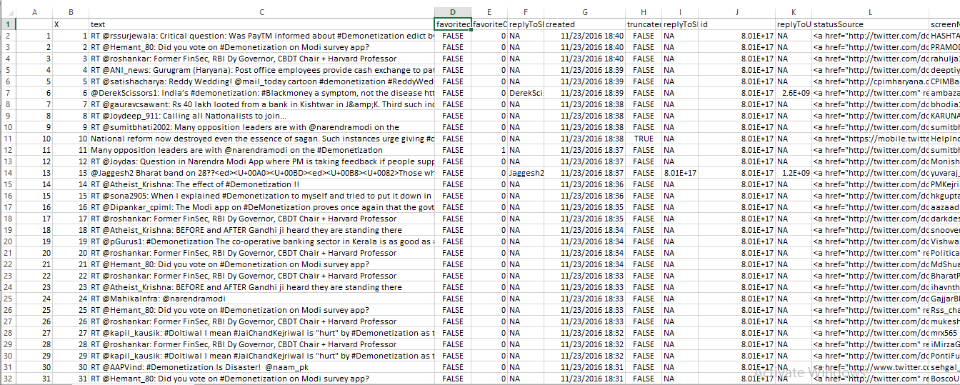

Slide 17
FLOWCHART

Slide 18
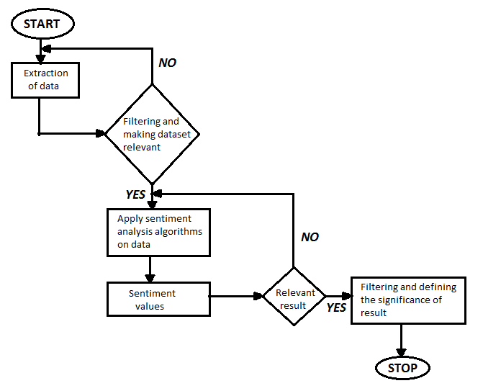

Slide 19
METHODOLOGY

Slide 20
After collecting raw tweets various preprocessing method get applied to clean the data. Same methods are applied for collecting and cleaning raw tweets for preparing testing dataset. After preparation of training and testing dataset various classifiers get applied to analyze the performance of classifiers.
Data Extraction
Training and testing tweets collected from twitter by using twitter API and python library tweepy on the topic “Demonetization”. Extracted tweets is only in English language.
Data Cleaning
Tweets are sometime not in the usable format. To get a tweet in usable format various preprocessing methods for cleaning tweets are applied. All special character and hyperlinks is removed from the tweets.

Slide 21
Training and Testing Dataset
For classifying a dataset, three classes Positive, Negative, Neutral are used. To classify tweets in to these categories following algorithms are used –
1. Naive-Bayes
2. Maximum Entropy
3. SVM

Slide 22
NAIVE-BAYES
Naive Bayes is used by many researchers to detect the sentiments of tweets. It works using probabilistic model given below for each of k possible outcomes or classes -
p(Ck | z1....zn)
Bayes theorem decomposes the conditional probability as –
p(Ck|z) =p(Ck) p(z|Ck)/p(z)
where Ck is class for each of k possible outcomes and z are the instances to be classified.

Slide 23
SVM
SVM is a non-probabilistic binary linear classifier. It has the ability to linearly separate the classes by a large margin. Add to it the Kernel, and SVM becomes one of the most powerful classifier capable of handling infinite dimensional feature vectors.
SVM is a supervised machine learning algorithm which can be used for both classification or regression challenges. However, it is mostly used in classification problems.
In this algorithm, we plot each data item as a point in n-dimensional space (where n is number of features you have) with the value of each feature being the value of a particular coordinate. Then, we perform classification by finding the hyper-plane that differentiate the two classes very well .

Slide 24
RESULT

Slide 25
 | POSITIVE | NEGATIVE | NEUTRAL
 | NAIVE BAYES (in %) | SVM (in %) | NAIVE BAYES (in %) | SVM (in %) | NAIVE BAYES (in %) | SVM (in %)
WEEK 1 | 32.90 | 27.00 | 15.00 | 15.00 | 52.10 | 58.00
WEEK 2 | 28.50 | 23.00 | 9.80 | 9.80 | 61.70 | 67.20
WEEK 3 | 33.40 | 35.60 | 13.40 | 12.30 | 53.20 | 52.10
WEEK 4 | 43.70 | 46.20 | 16.80 | 13.30 | 39.50 | 40.50
WEEK 5 | 34.10 | 77.10 | 16.30 | 16.90 | 49.60 | 6.00
WEEK 6 | 46.00 | 44.20 | 14.80 | 13.30 | 39.20 | 42.50
WEEK 7 | 61.20 | 63.10 | 11.10 | 8.50 | 27.70 | 28.40
WEEK 8 | 61.20 | 88.40 | 6.17 | 9.40 | 32.63 | 2.20

Slide 26
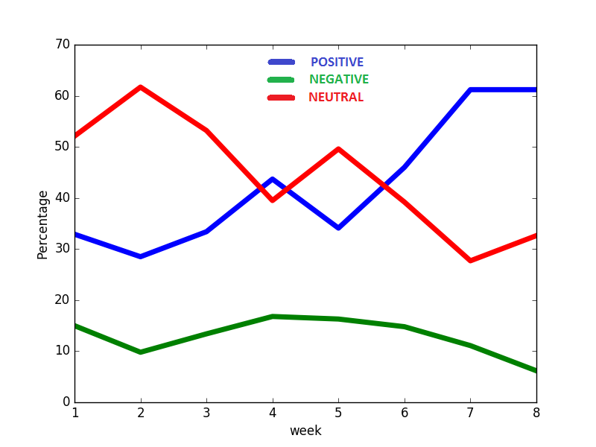
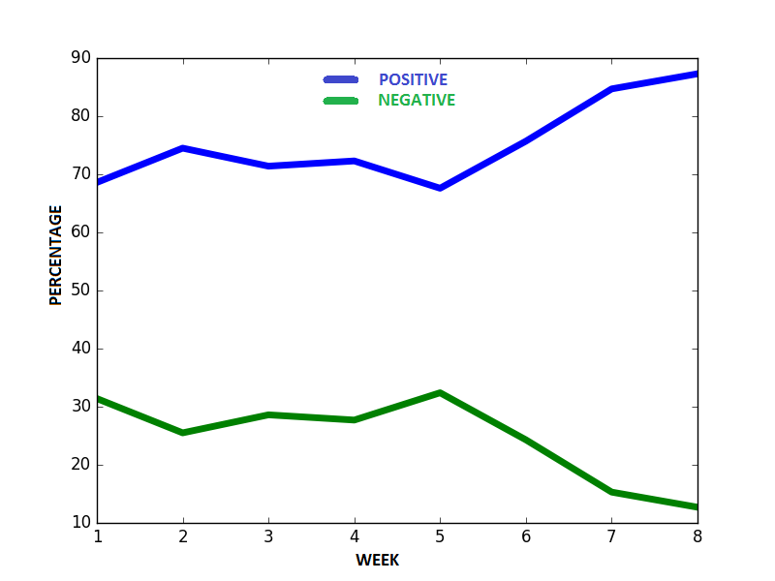
NAIVE BAYES
Figure 1.1: Comparison between
all sentiments.
Figure 1.2: Comparison between
positive/negative sentiments.

Slide 27
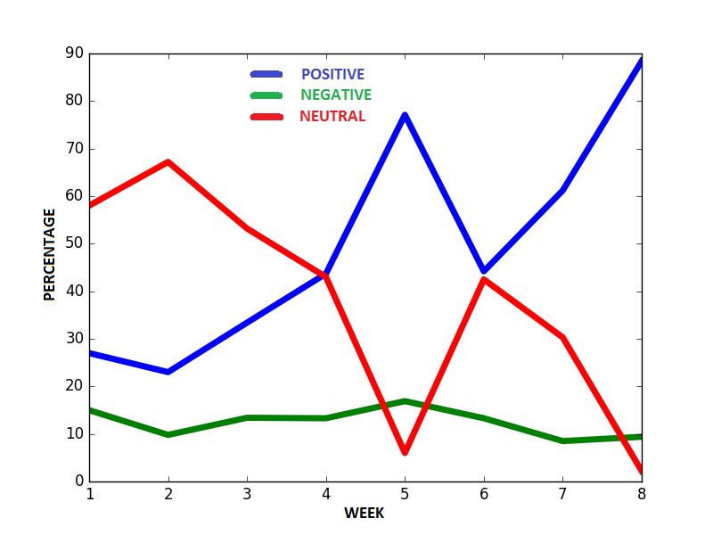
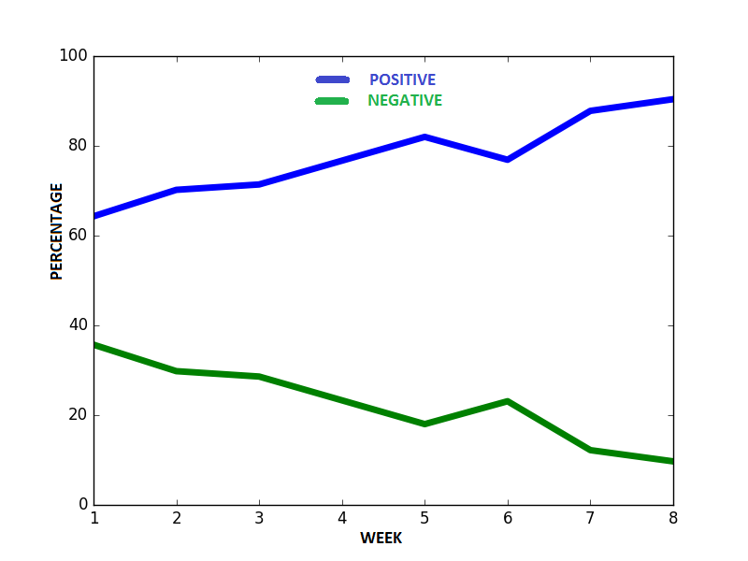
SUPPORT VECTOR MACHINE
Figure 2.1: Comparison between
all sentiments.
Figure 2.2: Comparison between
positive/negative sentiments.

Slide 28
The study shows that with every passing week, negativity in the sentiments started to decrease and the number of positive responses increased.
Twitter includes a great proportion of our population but not everyone.
Only upper and middle class of our society has access to social media and their opinion matters the most.
Our analysis suggests that majority of users believe that demonetization is beneficial for our country.
Our thesis shows that most of the users reacted positively towards demonetization process as well which makes it a success.

Slide 29
But the prominent newspapers suggests that more than half of the population faced problems during demonetization.
Contradiction has occurred between ours and newspapers statistics because of the widely distributed proportion of our society over different media.
Money exchange was the main issue with Demonetization which was mostly faced by lower and working class people due to lack of digitalization among them.
Hence , It concludes that “Demonetization” was not fair for everyone but appreciated by upper class people.
These results are based on short term opinions but we can’t predict how much beneficial it will be in future.

Slide 30
THANK YOU!

